Slide 1

Computational Fluid Dynamics II H-Grid and C-Grid Grid Generation
Muhammad Nauval Hamzah – 23620024
Mohammad Zaini Ma’ruf - 23620015

Slide 2
Flowchart
INPUT
Geometry definition, Airfoil, domain size, No of points
Topology Definition
H-Grid or C-Grid
Boundary Definition
Transformation to computational domain
TFI
Smoothing with Elliptic PDE
Mesh Checking
Show RESULT

Slide 3
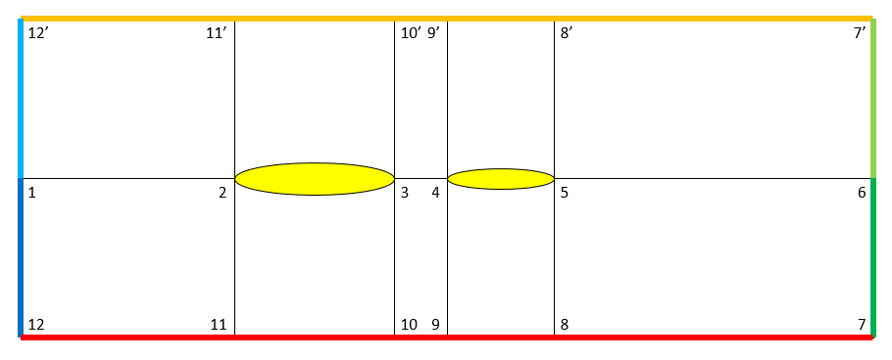
H-Grid Physical Domain

Slide 4
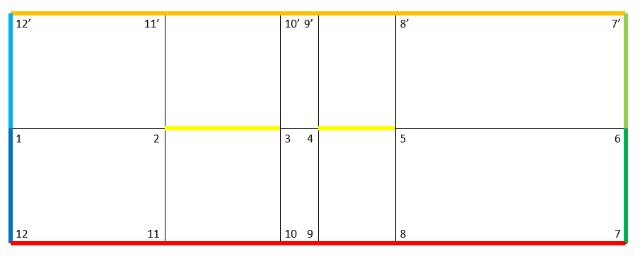
H-Grid Computational Domain

Slide 5
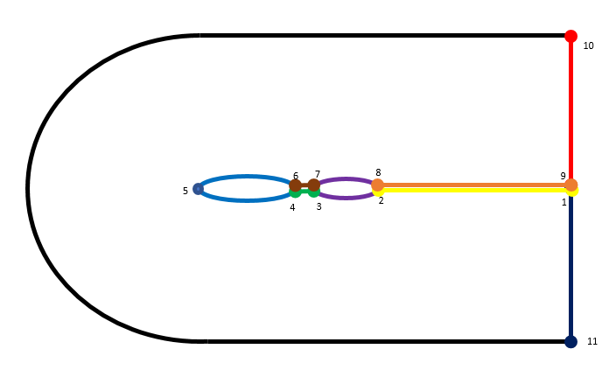
C-Grid Physical Domain

Slide 6
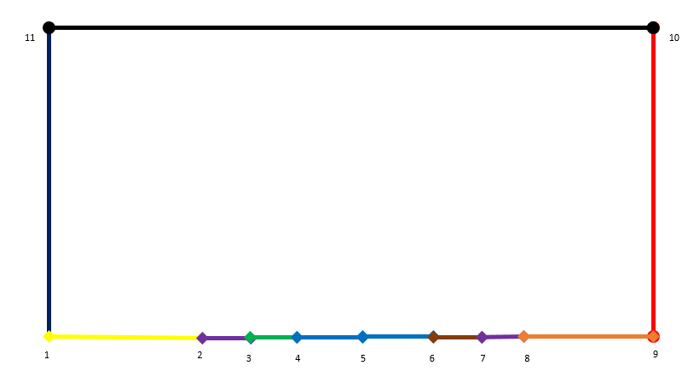
C-Grid Computational Domain

Slide 7
13
rOutflow
12
rFarfield
Gap
Aifoil Wake
7
8
9
10
6
11
5
4
3
2
1
Chord
Flap
Outflow
15
14

Slide 8
15
14
13
12
1
2
3
4
5
6
7
8
9
10
11

